Slide 1


Drupal AI Factchecker
Claim-level verification on your own corpus. powered by AMD.
Team: Drupal AI Router (Leo Fishman)
License: GPL-2.0+, published on drupal.org
Notes:
Muy bueno !!!!!! Excelente!!!!

Slide 2



The Problem with Current Tools
Pre-existing software is excessively expensive and operates as a closed, proprietary system.
Universities and governments have almost zero control over how their sensitive data is processed.
Tools detect copying, not falsehoods. AI-generated essays are "original" and undetectable.
Editors and educators lack an in-workflow tool to verify factual accuracy.

Slide 3


The Solution: Native Integration & Control
Where the content lives, under your control.
Institutions facing this problem (governments, universities) already run Drupal massively (.edu, .gov).
Unlike closed SaaS products, a highly configurable open-source Drupal module offers tight integration with your own content, keeping your data strictly in-house.

Slide 4








The Product: Native Integrity Suite
1. Factcheck
2. AI Likelihood
3. Verbatim Plagiarism
Atomic claim extraction and evidence retrieval. Per-claim verdict (SUPPORTED / UNSUPPORTED / CONTRADICTED) with auditable score.
0–100 score with rationale. Honestly framed: presented as a contextual hint, not a definitive mathematical proof.
Identifies the text's most distinctive sentences and searches them as exact phrases on the web to detect unoriginal copies.

Slide 5









Key Differentiators
Evidence Cascade
Distrust List
100% Auditable
The university's OWN indexed corpus is prioritized first. Verdicts are securely grounded in your institutional knowledge.
Claims echoed only by known misinformation domains are marked as tainted. Misinformation sites asserting a claim counts AGAINST it.
Every model call and routing decision is meticulously logged. No other tool combines local evidence with transparent logging.

Slide 6
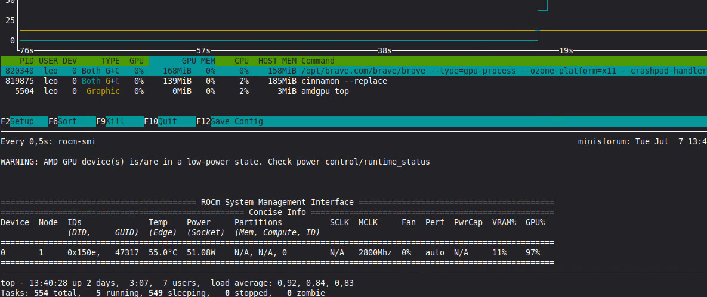
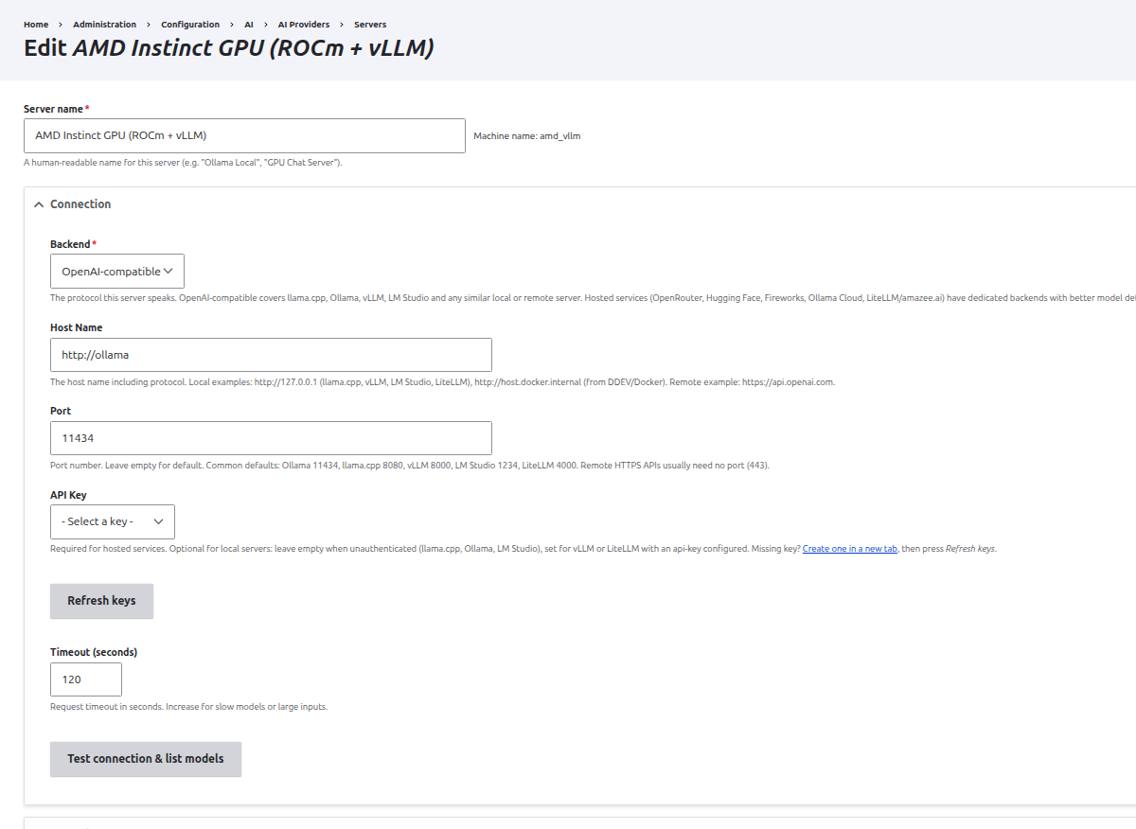
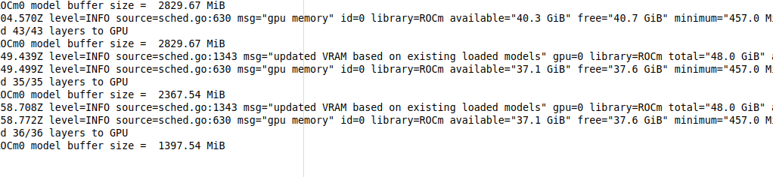
Powered by AMD Instinct & Ryzen
All inference (claim extraction + verification) runs on an AMD Instinct GPU: ROCm 7.2 + vLLM 0.16 serving Gemma.
Student work NEVER leaves institution-controlled hardware.
Local GPU Execution
rocm-smi execution inhouse
Drupal AI Integration
AMD server endpoint in Drupal

Slide 7

Architecture Flow
Trigger: Drupal Node → Content Scan
Routing: ai_provider_universal router
Processing: AMD GPU (vLLM/Gemma)
Retrieval: Vector index (local corpus) + Tavily (web)
Auditing: Securely logged decisions report
Everything—models, backends, evidence sources, trust lists—is Drupal configuration, not code.

Slide 8

Real and Ready
Built as a real, production-ready open-source module on drupal.org.
Built directly on top of the official Drupal AI ecosystem.
Backed by months of prior foundational work.
Hackathon Delta: Adding the critical AMD serving layer and defining the university use case.

Slide 9
Market Opportunity
Sizing the content integrity and plagiarism detection landscape.
$1.2B
PLAGIARISM DETECTION MARKET
schoolReady for Enterprise Budgets
Universities already allocate massive budgets for content integrity tooling. This solution slots perfectly into their existing CMS at a fraction of the cost.
businessMulti-Sector Expansion
Beyond academia, the exact same pipeline serves the urgent needs of newsrooms, investigation academies, and government content teams which most of them are already in Drupal.

Slide 10

Claim-level truth.
Where the content lives, on AMD.
GitHub Repo & Demos
https://github.com/leofishman/amd-hackathon https://amd-hackathon.fishman.work/
Demo Video Link
https://www.youtube.com/watch?v=WqwtFhDbv20
drupal.org Project Page
https://www.drupal.org/project/ai_provider_universal

